Slide 1
Chess Game
Dinu Sergiu-Andrei

Slide 2
Modes
Player vs Player
Player vs Computer
Computer vs Computer

Slide 3
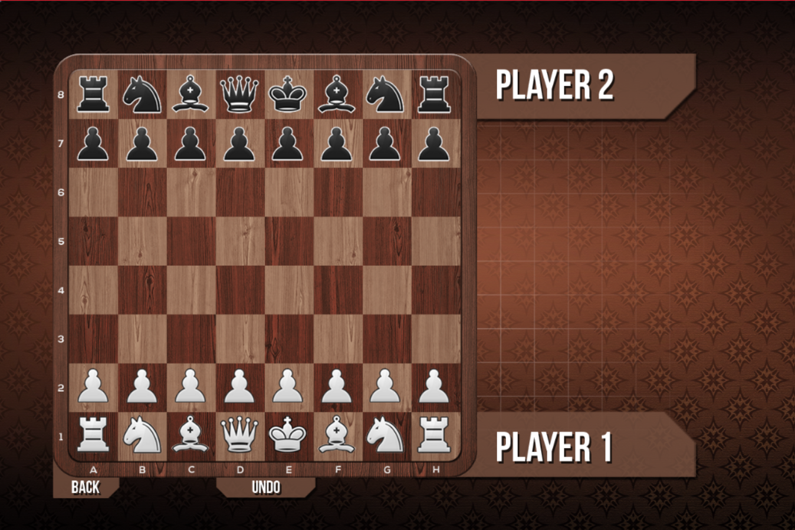
Player vs Player

Slide 4
Player vs Player
In this mode two players play against each other on the board.
All chess rules are applied during the match, including
- castles
- en-passant
- pawn promotion

Slide 5
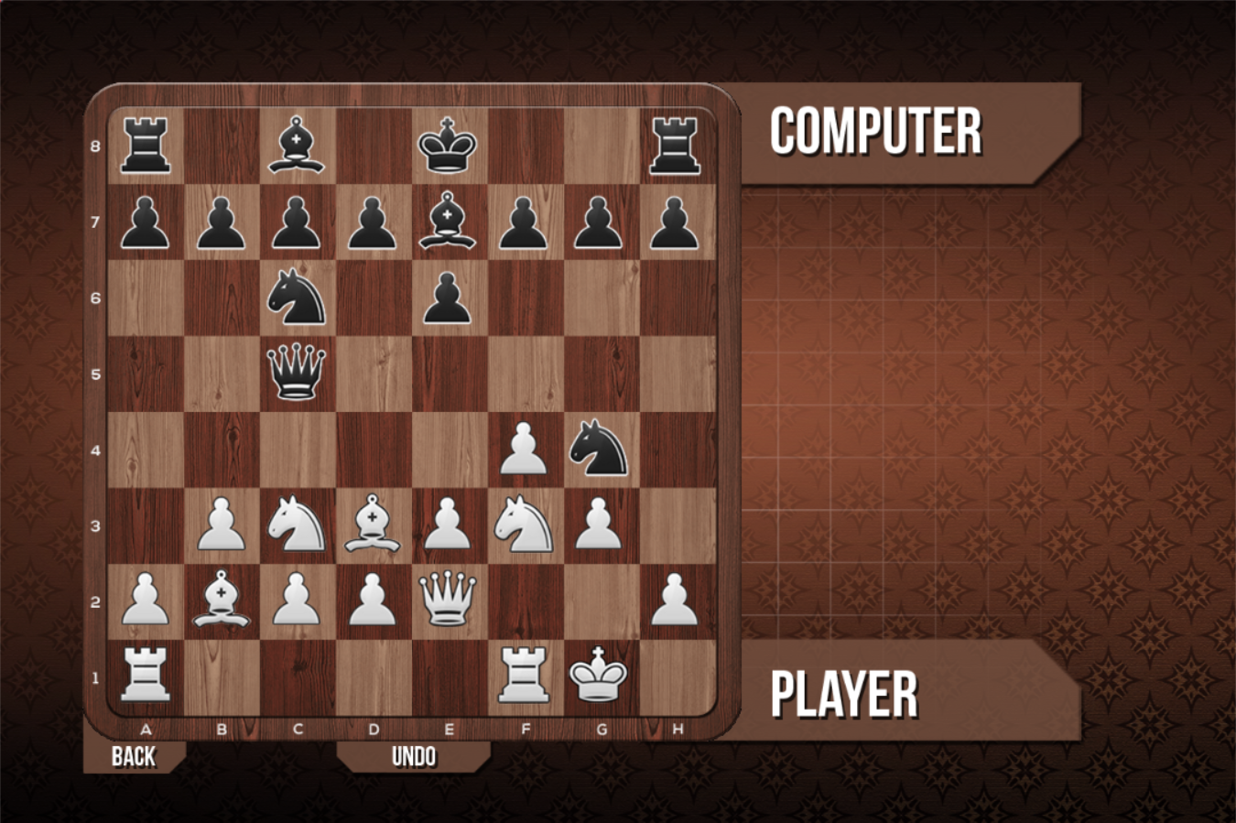
Player vs Computer

Slide 6
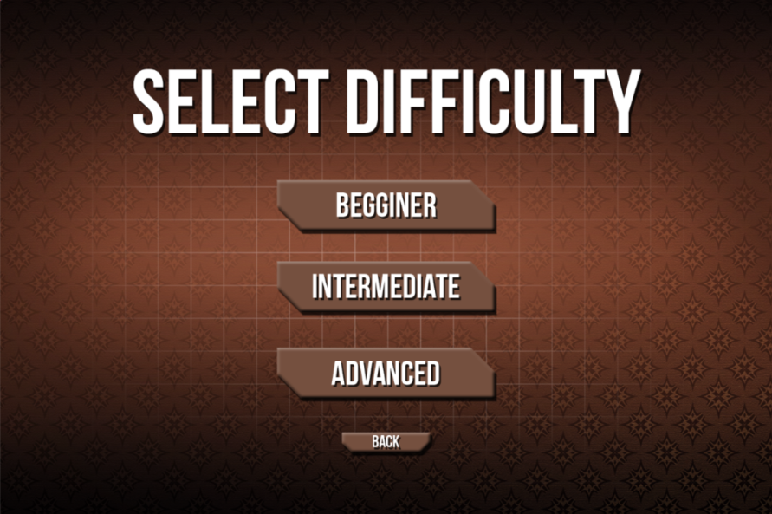
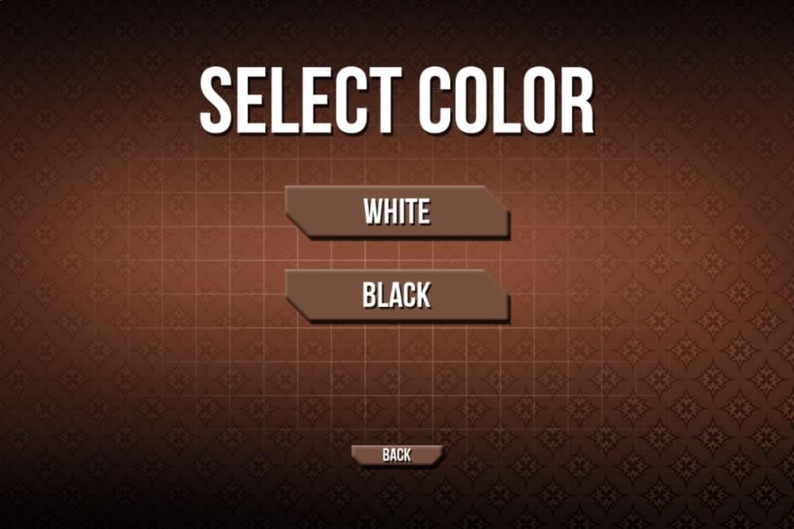
Player vs Computer
In this mode the user is able to select color of play and computer strenght

Slide 7
Player vs Computer (Beginner)
For players:
- with little chess experience
- learning how pieces move across the board
- who have just started playing chess

Slide 8
Player vs Computer(Intermediate)
For experienced chess players.
The Computer
- makes much better moves
- avoids losing pieces
- has little understanding of piece activity
- poses problems for the player

Slide 9
Player vs Computer (Advanced)
For players used to competitive chess competitions.
The computer
- has deep understanding of the position
- tactics and strategy
- 20 to 40 seconds per move (faster than a human's calculation in competitive chess )

Slide 10
Player vs Computer
Training
Checking play level
Just for fun

Slide 11
The Chess Engine
Able to calculate to fixed depth
Possiblity of Deep Calculation
Choses the most ‘unpleasant’ move for opponent
Mate search

Slide 12
Engine vs Engine (Demonstration Mode)
The user first chooses the level for each engine before starting the match.
The possible levels are "Beginner", "Intermediate", "Advanced".
This mode is useful for seeing the strenght difference between engines.

Slide 13
Demonstration Matches
Beginner vs Beginner
https://www.youtube.com/watch?v=Wvfl_-vXiiE
Intermediate vs Intermediate
https://www.youtube.com/watch?v=dSthGIrPcGA
Advanced vs Advanced
https://www.youtube.com/watch?v=5YiO0EepPHA

Slide 14
Demonstration Matches
Intermediate vs Beginner
https://www.youtube.com/watch?v=cnppwbfScLU
Advanced vs Intermediate
https://www.youtube.com/watch?v=y4SA-eS7ZpM
Beginner vs Advanced
https://www.youtube.com/watch?v=0rvG_hYP7lg

Slide 15
Thank you for you attention
Dinu Sergiu-Andrei

